Slide 1

NATIONAL AND INTERNATIONAL INSTRUCTORS AND MENTORS
I-CORPS

Slide 2
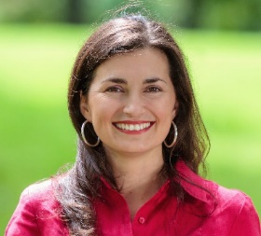
INTERNATIONAL INSTRUCTORS*
Rosibel Ochoa, Associate Vice Chancellor Technology Partnerships
Specialties: Early stage technology commercialization, Translational research, Licensing, Energy Storage, Materials, Catalysis
Alexandra Orozco, Associate Director International Partnerships
Specialties: Leadership, Strategy, Branding, Sustainability
Rosibel Ochoa is the Associate Vice Chancellor Technology Partnerships at U.C. Riverside. She previously provided leadership to UCSD's von Liebig Center, a unique proof-of-concept program that helps accelerate the transfer of faculty innovations into the private sector and provides entrepreneurial education to graduate students in science and engineering. She is the founder of TekDome LLC, a consulting company that provided expert advice on strategies for intellectual property development, commercialization and licensing support. Rosibel also served as a commercialization consultant to the Research Triangle Institute, the Georgia Institute of Technology and several university startup companies. Previously, Rosibel served as Associate Director of the Office of Technology Licensing and Manager of the Industry Contracts Group at the Georgia Institute of Technology. Working with Georgia Tech's Venture Lab, she managed proof of concept grants to faculty interested in commercialization of clean technologies. Before joining Georgia Tech, Rosibel worked at Motorola's Energy Systems Group (ESG) and at MeadWestvaco as a research engineer, developing materials for advanced lithium polymer battery technology and carbon-based super capacitors. As part of the business strategy team at Motorola, she helped identify and evaluate new business opportunities in emerging energy technologies such as fuel cells, Bluetooth and battery chargers. Rosibel received a PhD and MS in Chemical Engineering from the University of Louisville. She is the inventor of two issued patents and the author of more than 18 scientific publications.
Alexandra Orozco brings 15 years’ experience in senior leadership roles building and leading startups in life sciences with a focus on strategic marketing and planning. She has spent 20 years as a professional in marketing development and implementation. Alexandra is the Associate Director for International Partnerships EPIC, at UCR as well as part of the teaching team for the UCR I-Corps program. She is also a partner in Earthlogic, a strategy, branding, and international business consultancy firm working with start-ups as well as small and medium size firms in North and Latin America in a variety of sectors including CleanTech, IT, Biomedical, Biotech, Nutraceuticals, and Education among others. Alexandra is a start-up mentor, a sustainability advocate and a partner in several life sciences start-ups.
Prior to joining Earthlogic, Alexandra was a Partner and Vice President of Marketing for Ascenta Health now part of the Schwabe Group. Prior to this, Alexandra held senior marketing roles within the telecommunications, contact center, and hospitality industries. Fully bilingual in Spanish and English, Alexandra is an MBA graduate from Dalhousie University in Halifax, Nova Scotia Canada, and holds an International Business Administration degree from EAFIT University in Colombia.
* Los instructores llevan versiones resumidas del programa NSF I-Corps a sus sitios locales para fortalecer los ecosistemas de innovación y contribuir a una red nacional de mentores, investigadores, empresarios e inversores.

Slide 3
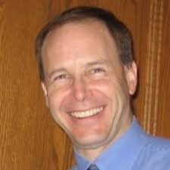
INTERNATIONAL INSTRUCTORS
Eric Gosink, Entrepreneur in Residence and Mentor
Specialties: Early stage technology commercialization, Medical & life science research, Licensing, Marketing, Business development
Carolina Rosas, Mentor
Specialties: Biotechnology, Biology.
Eric Gosink has worked for 18 years leading and directing technology licensing, commercialization and business development programs. Prior to joining UC Riverside, he served as the Director of Technology Transfer for Loma Linda University Health (LLUH) where he built key processes and organized teams to evaluate and commercialize translational biomedical research, while simultaneously reducing patent expenses by almost 90%. Most recently, he laid the foundations for entrepreneurial development in starting n³eight, a business incubator program at LLUH. Eric has served as a commercialization consultant for multiple universities, led the successful launch of a new cell culture product line at Life Technologies Corporation, and held senior technology transfer roles at UC San Diego and the University of Utah.
Eric served as a post-doctoral research fellow studying cellular biology after receiving a PhD and MS in Physiology from the University of Wisconsin, Madison. He also worked as a research technician for the Veterans Administration Medical Center and obtained a BA in Biochemistry & Cellular Biology from UC San Diego.
Carolina is a co-founder of Klein Biotecnología Ltda, a Chilean biotechnology startup. She is also the founder of Vitrotech SpA, a consulting start-up company focused on consulting services for bio-business. Carolina has experience in business formation, fund raising, patent strategies and technology transfer.
She has been Director and Co-director of several R&D grants and currently she is an Entrepreneur-in-Residence at the Office of Technology Partnerships in the University of California Riverside. In this capacity she mentors entrepreneurs and promotes the development of small businesses and scalable start-ups in the Inland Empire. Carolina is also responsible for outreach activities to promote entrepreneurship within the faculty and student base at UCR. She is passionate about sports, in particular female and male soccer.
Carolina is a Molecular Biotechnology Engineer and holds a Master in Molecular, Cellular and Neuroscience Biology from the University of Chile.

Slide 4
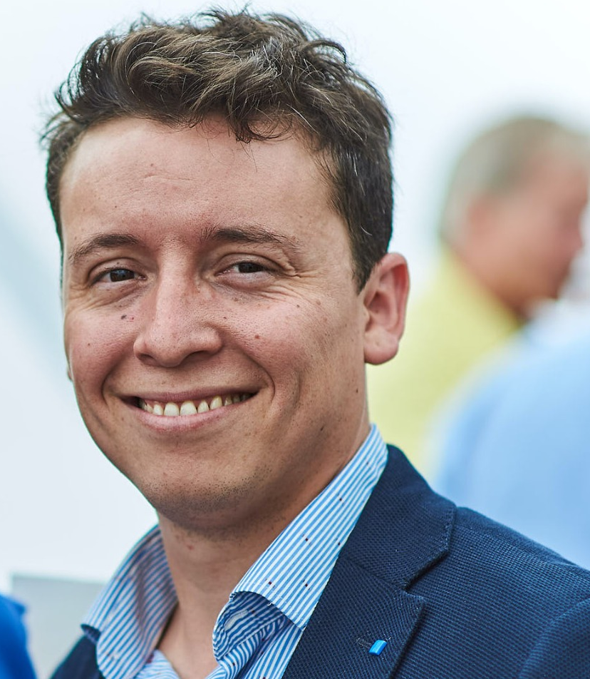
NATIONAL INSTRUCTORS
Javier Ramirez, Chief Executive Officer at Know Hub Chile
Specialties: Leadership, Strategy, legal advising, Innovation.
Fernando Venegas, Chief Technology Transfer Officer at Know Hub Chile
Specialties: Strategic Planning, Negotiation, Intellectual Property, Technology Transfer
Javier has served in different leading positions in the field of technology transfer and innovation. He founded and served as the first Director of Innovation for the U of Chile and he also led the creation of the first Technology Transfer Office for the U Andrés Bello. Javier also collaborated with the installation of UC Davis Chile Life Sciences Innovation Center, as its Chief Business Development Officer, among other positions.
He has a law degree (Pontificia U. Católica of Chile) with an LLM in intellectual property (U. of Alicante Spain) and a master degree in Business Administration (MBA U. of Chile). He has also completed different specialization courses in the area of innovation, having recently obtained a UCR certification as an i-Corps instructor.
Fernando has a solid background in entrepreneurship, innovation policies, intellectual property and technology transactions. In 2015, he was part of the Subcommittee on University Regulations for Innovation of the Presidential Commission for Science for the development of Chile.
He has worked as Head of Intellectual Property unit at the Universidad de Chile, where managed the university's IP portfolio and participated on technology licensing processes. Subsequently, he served as associated lawyer at Estudio Villaseca, where he advised international companies and Startups. Besides, he developed different innovation policies and technology transfer strategies for universities and national companies.
Fernando Venegas graduated from the Universidad de Chile with a law degree. Afterward, he got a master´s degree in law and new Technologies from the Universidad de Chile and an MBA from the Universidad Adolfo Ibáñez. He has different specialization courses in technology transfer and entrepreneurship in US, UK, Israel and China.

Slide 5
NATIONAL INSTRUCTORS
Oscar Astudillo, Technology Transfer Coordinator at Know Hub Chile
Specialties: Leadership, Agronomy, plant varieties, Licensing.
Oscar was Head of the Technological Marketing Unit of the Universidad de Talca. Óscar began his career as a researcher in fruit growing at the Raihuen Institute of Agricultural Research (INIA), in the Maule Region, where he became Regional Deputy Director of Research and Development.
Today he is the technology transfer coordinator at Knowhub Chile, with more than 12 years of experience in innovation management and technology transfer processes, technology commercialization, technology portfolio construction, evaluation of emerging technologies and technology-based entrepreneurship, as well as in licensing processes of plant varieties and science company linkage campaigns.
He is Agricultural Engineer, Master in Technological Management with an emphasis in Biotechnology and a diploma in Technified Irrigation from the University of Talca.

Slide 6
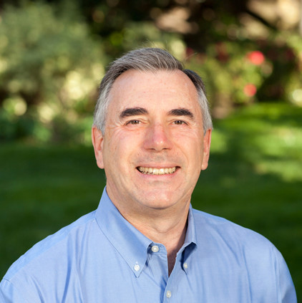
INTERNATIONAL MENTORS*
Jay Gilberg, Instructor and Mentor
Specialties: Entrepreneurism, Venture Capital Funding
Richard Kuntz, Entrepreneur in Residence and Mentor
Specialties: Healthcare, Medical Technology.
Jay Gilberg is an instructor and mentor at EPIC. As an entrepreneur, Jay founded and built an INC 500 Company, recognized as one of the 500 fastest growing, privately held companies in the US over a 5-year period. Since selling that company, he has been active as a business advisor and consultant, a real estate investor, and spent 4 years as lead instructor of entrepreneurism in the von Liebig Center's I-Corps Program. Jay’s specializations are often referred to as "soft skills" or the "human side" of enterprise.
He is an expert at determining and communicating professional goals, developing presentation skills and pitching, building a good reputation and a good network of contacts, recruiting founders and key employees, attracting investors and clients and creating a personal brand, team and organization that is inspirational and aspirational. At the von Liebig Center, Jay taught numerous cohorts of NSF I-Corps students who aim to commercialize their research and technologies. He utilizes Steve Blank's Lean Launchpad and Business Model Canvas extensively, as well as the business development models used at CONNECT and influences from Bill Aulet of MIT and HBR cases to teach many engineers how to think business. In the Fall of 2016 Jay transitioned to EPIC at UC Riverside where he continues to teach in the NSF I-Corps Program, to mentor emerging companies and to help build the entrepreneurial ecosystem.
Richard Kuntz is the Founder of Torrey Pines Venture Advisors, provides technology commercialization advice to academic researchers, scouts technology for U.S. governmental entities, and counsels early-stage companies pursuing financings and/or transactions.
As Managing Director of Shepherd Ventures for 16 years, and previously in leadership roles at other institutional investment organizations, Rich has amassed nearly 35 years of investment, transaction, operational, and board level experience with early-stage and high-growth technology companies, particularly those operating within healthcare, medical technology, and life sciences. As a founding board member, he has helped create several companies formed to commercialize technologies licensed from major research institutions.
Rich has been active in the NSF I-Corps™ program for five years and has twice participated in the National phase as a mentor to teams from UC San Diego and USC. He is a Chartered Financial Analyst (CFA) with an academic background that includes SB and SM degrees in aeronautics and astronautics from the Massachusetts Institute of Technology, and an MBA from the Kellogg School of Management at Northwestern University.
* Los mentores ayudan a calificar el potencial de comercialización de la invención o idea, establecer hitos para el progreso y guiar a los equipos a través del proceso I-Corps

Slide 7
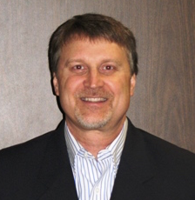
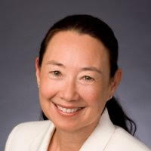
INTERNATIONAL MENTORS
Ken Gruys, Entrepreneur in Residence and Mentor
Specialties: Agricultural Biotechnology and Technology R&D.
Leslie Hickle, Entrepreneur in Residence and Mentor
Specialties: Biotech Startups, Biopharmaceuticals, Agriculture, Animal Health, Renewable Energy.
Ken currently is a Senior Advisor in Technology Partnerships at UC-Riverside, and is a Professor and Director of Team Master’s Project at Keck Graduate Institute in Claremont, CA.
Ken has 25 years of R&D experience in the private sector working primarily in the area of Agricultural Biotechnology. Ken is a recognized technology innovator and leader, and in his various roles has overseen the discovery and development of valuable Biotech traits in crops. In addition to his passion in the development of new products through scientific innovation, Ken has been an instructor on project planning and leadership, and the development of successful teams. Fostering individual growth and development is a hallmark of Ken’s philosophy to organizational success.
Ken Gruys received his BS degree in Chemistry from Gustavus Adolphus College in Minnesota and his PhD in Chemistry from the University of Nebraska-Lincoln. Ken was an NIH Postdoctoral Fellow at the Institute for Enzyme Research and the Department of Biochemistry at the University of Wisconsin-Madison, and in 2009 completed the Stanford Executive Program at the Stanford University Graduate School of Business in Palo Alto, CA.
Leslie is Vice President, New Business for BioAtla, a San Diego biopharmaceutical company developing Conditionally Active Biologic drugs to treat cancer. She has extensive R&D leadership, business and transactional experience across multiple industries leading to several legacy products with multi-million dollar sales. Prior to joining BioAtla, she managed the San Diego headquarters and led corporate development for Synthetic Genomics, a company founded by Dr. Craig Venter to progress the development of biobased fuels and synthetic biology. Previous to SGI, while at Diversa, AgriLynx, Mycogen and Stauffer Chemical (now Syngenta) she played critical rolls in R&D, as well as identifying and fostering strategic alliances with commercial partners. She has led and mentored teams that have developed novel chemical and biopesticides, plant traits, vaccines, therapeutics, and technology platforms; she is co- inventor on issued and pending patents, is editor of a book on analytical chemistry, and co-author of publications in animal health and agriculture. She has co-founded successful biotech companies and served as a business and technical consultant to Bayer, California EPA, Schering Plough, Pioneer Hi-Bred, DuPont, Dow Chemical, and California Poultry Federation.
Leslie received both her BS (Biology/Chemistry) and PhD (Entomology/Toxicology) from the University of California Riverside. She is a Certified Board Director (UCLA Anderson School of Business) and serves on advisory boards for the UC Riverside College of Natural and Agricultural Sciences (CNAS), the UC Innovation Council and several biotech startups

Slide 8
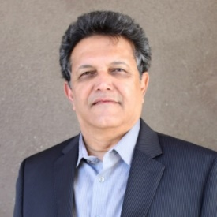
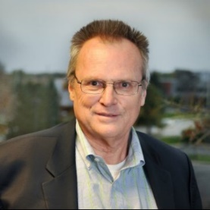
INTERNATIONAL MENTORS
Anil Shanbhag, Entrepreneur in Residence and Mentor
Specialties: Water, Aerospace, Defense.
Art Salyer, Entrepreneur in Residence and Mentor
Specialties: Batteries, Entertainment.
Anil Shanbhag is an accomplished manufacturing industry executive having run global businesses in a career spanning over twenty-five years. Mr. Shanbhag is passionate about combining his technical expertise and business acumen to facilitate the growth of global manufacturing-centric economy in Southern California. Mr. Shanbhag has held senior executive positions in billion dollar, publicly traded companies such as Esterline Technologies and TriMas Corporation. Throughout his career, he has led businesses that manufactured highly engineered, mission-critical components, assemblies and systems, primarily in the aerospace and defense sector.
Over the past few years, Mr. Shanbhag has played a pivotal role in the transformation of small businesses and startups by providing his expertise to develop and execute strategic and tactical plans. Currently he is the Chief Marketing & Sales Officer for Aquaback Technologies, developer of a patented water treatment technology. Mr. Shanbhag is also the Co-Founder of a start-up that has discovered a better way to transfer hybrid electric power to an open wheeled vehicle, with applications in medical, railroad and bicycle industries. Additionally, he is mentoring two start-ups engaged in medical orthotics and consumer beverage cooling technologies. He is also a mentor for Make in LA, a San Fernando area based accelerator for hardware star-ups.
Mr. Shanbhag holds Bachelor’s and Master’s degrees in Chemistry from University of Bombay, Master’s degree in Engineering from University of Massachusetts, and Executive M.B.A. from Peter Drucker School of Management at Claremont Graduate University.
Art Salyer is a business leader with broad “C” level experience. He has “hands-on” experience effectively managing businesses with operations in North America, Latin America, Asia, Eastern and Western Europe.
His most recent role was as COO of SDI Media, one of the largest independent dubbing and subtitling companies operating 38 locations around the world involved in 60 different languages. Customers included Apple, Warner, Universal, and virtually all major media suppliers. This role was completed with a planned successful sale to a consortium of Japanese entertainment companies and government agencies.
Prior to SDI Media, Art was the successful CEO of Palladium Energy. Palladium is one of the largest independent producers of lithium batteries and power supplies for consumer and industrial applications. Customers included Apple, Samsung, Microsoft, Sony, Bose and a variety of others. Art was responsible for the successful transition of this business unit into a growing independent company with manufacturing and technology centers in Europe, China, Brazil and the United States. This assignment concluded with a successful merger with a primary competitor.
Art has had a number of increasingly responsible roles in large and smaller businesses including: technology post startups, battery and power supplies, retail consumer electronics, entertainment and media, consumer and office products, and food. The focus of his work has typically been in the operations/manufacturing/services areas.
At present, Art is a senior partner at Global Interim Executives LLC. This boutique consulting firm specializes in shorter-term executive assignments, private equity and venture capital operations support, turnaround leadership, and executive coaching/development. His focus is both US-based and global assignments.
Art has an Engineering degree from California State University and an MBA from Pepperdine University.

Slide 9
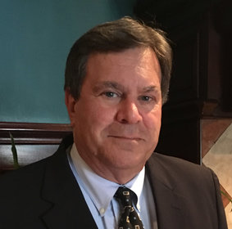
INTERNATIONAL MENTORS
Doug Kollmyer, Entrepreneur in Residence and Mentor
Specialties: Sales Management, Marketing, Strategic Planning
Eric Gosink, Entrepreneur in Residence and Mentor
Specialties: Early stage technology commercialization, Medical & life science research, Licensing, Marketing, Business development
Doug Kollmyer has 35+ years’ experience in sales management, business development, marketing, strategic planning, distribution and channel strategy, manufacturing and service operations, team building, and P&L responsibility. Doug has experience in large, medium and small companies, in several industries, including automotive, HD trucking and transportation, RV’s, real estate and construction. As an entrepreneur in a franchised real estate business he understands the challenges of building a company from the ground up. He and his teams have recruited, trained, motivated and managed both direct and indirect channel sales for manufacturing and service organizations. Doug is creative and analytical in approach, and has developed skills in virtually every aspect of business, excelling in sales management, marketing, team building and organizational change.
As a “change agent” with a wide range of skills and experience, Doug is uniquely positioned to help businesses grow through leveraging technology, improving sales process and sales management by implementing the SalesQB system.
Doug is an avid skier who took up golf as a sport to pursue between winters, and is the father of two adult children, both also avid skiers. He earned a BS in Psychology and an MBA at Arizona State University.
Eric Gosink has worked for 18 years leading and directing technology licensing, commercialization and business development programs. Prior to joining UC Riverside, he served as the Director of Technology Transfer for Loma Linda University Health (LLUH) where he built key processes and organized teams to evaluate and commercialize translational biomedical research, while simultaneously reducing patent expenses by almost 90%. Most recently, he laid the foundations for entrepreneurial development in starting n³eight, a business incubator program at LLUH. Eric has served as a commercialization consultant for multiple universities, led the successful launch of a new cell culture product line at Life Technologies Corporation, and held senior technology transfer roles at UC San Diego and the University of Utah.
Eric served as a post-doctoral research fellow studying cellular biology after receiving a PhD and MS in Physiology from the University of Wisconsin, Madison. He also worked as a research technician for the Veterans Administration Medical Center and obtained a BA in Biochemistry & Cellular Biology from UC San Diego.

Slide 10
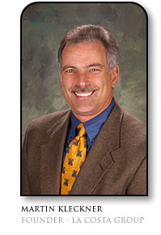
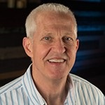
INTERNATIONAL MENTORS
Martin Kleckner III, Entrepreneur in Residence and Mentor
Specialties: Business Development, Operations.
Steve Sharp, Entrepreneur in Residence and Mentor
Specialties: Marketing, Management, Operations.
Martin Kleckner has 28 years experience in operations and business development in life sciences, healthcare, oil & gas, and cable television. He has advised over 115 emerging and Fortune 100 companies with corporate planning and strategy, commercialization and public policy throughout Europe, Asia & the Americas. He participated as founder or early-stage employee in five venture start-ups with two successful exits. He was a co-founder/Senior Vice President of RefluxMD.com, a Health 2.0 Internet company specializing in gastroesophageal reflux disease and Senior Advisor to Respiratory Technology Corporation (ResTech). He was co-founder of U P Laboratories in San Diego. Earlier he was an investor and lead business development for RegeneMed, a company creating three dimensional (3D) engineered liver tissue for use in drug discovery research; co-founder and Chief Business Officer for Salvino-Flex LLC wherein he managed the research and development of a chest tube insertion device, ultimately selling the company. He was also Director of Development for Science & Engineering Associates for the commercialization of a companion diagnostic technology for cervical, ovarian and oral/pharyngeal cancers and SpyFinder, a hidden camera locator (used in a 2004 episode of CSI Miami). He has also provided commercialization advisory support and grant proposal review for the National Institutes of Health, Drexel Foundation, and Coulter Foundation. He received his PhD and MA in Public Policy from the University of California and MBA at the UCLA Anderson School.
Steve Sharp has 36+ years’ experience as a business executive, board member and business consultant, spanning startups to Fortune 500 companies. Category experience includes consumer packaged goods, office products and software, printing, graphic films, durable goods, chemical compounding and molding, and aerospace.
Worked at Avery Dennison in marketing and general management both in B2C and B2C businesses. Led marketing/new business development and operations/quality/planning/product engineering/HR/EHS at Trojan Battery (batteries), and marketing at Rain Bird (irrigation) and Mag Instrument (flashlights). Most recently was COO at Cabeau, a stage 1 company (travel accessories). 5½ years as a business consultant: owns and leads Sharp Performance Consulting, which serves primarily small-to-medium-sized manufacturing and distribution businesses in strategy, execution and driving growth. Served on two nonprofit boards: World Vision and currently with the Shepherd’s Pantry.
BA from Occidental College in psychology and economics and MBA from Anderson Graduate School of Management (UCLA), finance/marketing.

Slide 11
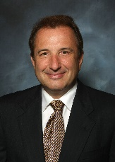
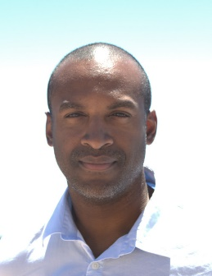
INTERNATIONAL MENTORS
Joseph Nadolsky, Mentor
Specialties: Market Research, Strategy.
Dwayne Nelson, Mentor
Specialties: Intellectual Property, Technology Transactions, Computer Science.
After a 21 -year career in the U.S army, Joe became a partner in McIntosh Manor, a medium size assisted living facility – originally planning to be a silent partner he was forced to become actively involved as the company failed in its initial market entry. As he worked to make the company profitable, he rediscovered his inner entrepreneur which led him to formalized business training at the Paul Merage School at UC Irvine. There he founded Neptune Diagnostics to commercialize genomic tests for the wastewater industry. The company won a National Science Foundation Small Business Innovation Research Grant that help the company test the scientific and market feasibility. Recently he joined DiCodon Diagnostics as its chief operating officer where he is responsible for the market discovery. Out of University of Pennsylvania, DiCodon diagnostics is revolutionizing genomic diagnostics with a new technique Protein Synthesis Monitoring (PSM).
Joe Is a graduate of The Citadel with a BS in Civil Engineering, holds a Master’s Degree in International Commerce from George Mason University and an MBA from University of California Irvine. He is a certified Project Manager. In his spare time, he trains for a yearly marathon, as well as volunteers his time in AYSO soccer, and is the president of The Citadel Club of Southern California.
Dwayne Nelson is a patent attorney at Nelson Patent Law. He is licensed to practice law in New York, New Jersey, the District of Columbia and in patent matters before the United States Patent and Trademark Office.
Dwayne has previously held research (computer science) roles at Science Applications International and IBM (Almaden). After studying law in Washington D.C., he returned to IBM Research (Watson) as an IP Attorney. At IBM, Dwayne held assignments at headquarters (Corporate Trademarks) and Software Group, where he supported Cloud Labs, portfolio management, licensing and acquisitions/divestitures.
In 2013, he left New York and moved to the Inland Empire to develop a technology for organizing news feeds. He founded Nelson Patent Law early in 2016 to support local innovation. Dwayne is interested in AI, IP, entrepreneurship and diversity/inclusion.

Slide 12
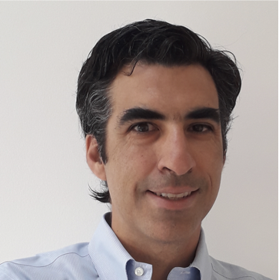
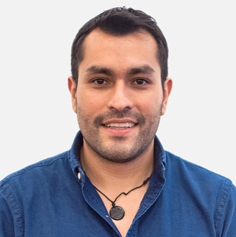
NATIONAL MENTORS
Diego Ibáñez, Mentor
Specialties: Leadership, Strategy, fund leverage.
Sebastián Melín, Mentor
Specialties: Innovation, Technology Transfer, entrepreneurship.
Diego brings 15 years of experiences in various industries (Forestry, Mining, Agribusiness, startups) and companies (Arauco, Agrolife, Pragmaxión and Octantis) developing new businesses, leading and envolving and implementing from scratch, reaming existing or emerging businesses.
Involved in Identification and evaluation of opportunities, defining of value offer for development of commercial strategies. Experiences in generation of business plans, opening international markets and valuing for leverage private and public funds. Diego has a strong focus on comprehensive management, implementation of initiatives, and entrepreneurial spirit at corporate and technology-based company.
Diego is Industrial engineer and MBA at Macquarie University, Australia with financial management diploma at UAI.
Sebastian is CEO and founding partner of Innoscience Group. Innoscience is a platform that connects research, science and technology based innovation with opportunities from industry. Sebastian is also Business Development lead for Datawheel Chile, a company that offers high-end solutions for data Integration, distribution, and visualization.
He brings over 10 years of experience in business development, project management, innovation, entrepreneurship, intellectual property and technological transfer, through international consulting for innovation and R&D projects throughout the region.
He holds a Master of Business at Monash University, Australia, and Bachelor of Science in Industrial Engineering from Universidad Adolfo Ibáñez, Chile. He has additional training from University of Texas Austin and Columbia University.

Slide 13
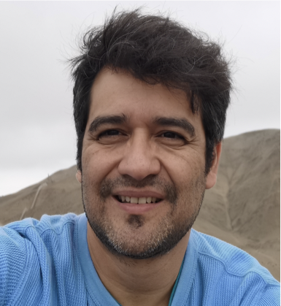
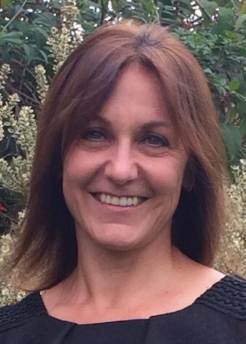
NATIONAL MENTORS
Gastón García, Mentor
Specialties: Ambiental management, Agroindustry, entrepreneurship.
Francisca Schäufler, Mentor
Specialties: Human Resource, Coaching
Gastón is Regional director of Business Development at Centro Innovo Universidad de Santiago de Chile, professor of biotechnological business and advisor of the technological transfer office at Universidad San Sebastian. Also, relator of entrepreneurship and valorization of knowledge together with technological park of Universidad de Chile and Universidad de Montevideo, Uruguay. Adviser at CORFO on agricultural area, designing strategical plans. With experience on soft landing of entrepreneur on Latin America. (Partner and capital leverage). Mentor at start up Bioincuba, Universidad Cayetano Heredia from Perú. Organizer and sworn of a competition of university entrepreneur GSEA for Chile.
he brings 15 years of experience national and international on Innovation, technological transfer, technology development and its incorporation to the market (Lab to market). Following up every step of the process (market prospection, valorization, productive scale up, fund leverage, define business model, commercialization strategy and intellectual property). Author of invention patents, applied on different offices all over the world (USA, Israel, South Africa, among others.
He is Biochemistry and master on Ambiental management and planification from Universidad de Chile.
Francisca brings 30 years of experience on Shell (Human Resources for 6 years), Retail Business (Business Development Manager at Ripley for 7 years), Education (Chief Executive Officer of Postgraduate MBA and Dual Degree at UAI for 10 years) and Senior Consulter in Human Resources (6 years) and General Manager of Adler Executive (1 years), Company focused on Talent and Management Development, Executive Search, Learning & Adult Education
Her knowledge is in advice and coaching in terms of behaviors and skills required to lead businesses, team coach in developing ventures and HR Topics.
She is psychologist from Universidad de Chile, MBA and Master in Management from Universidad Adolfo Ibañez, EdD(p) Adult and Organizational Learning from University of Liverpool, UK and International certificated Coach from Center of Creative Leadership (CCL), European School of Coaching and Newfield Network. Register member of women for directory of Women Ministry of Chile.

Slide 14
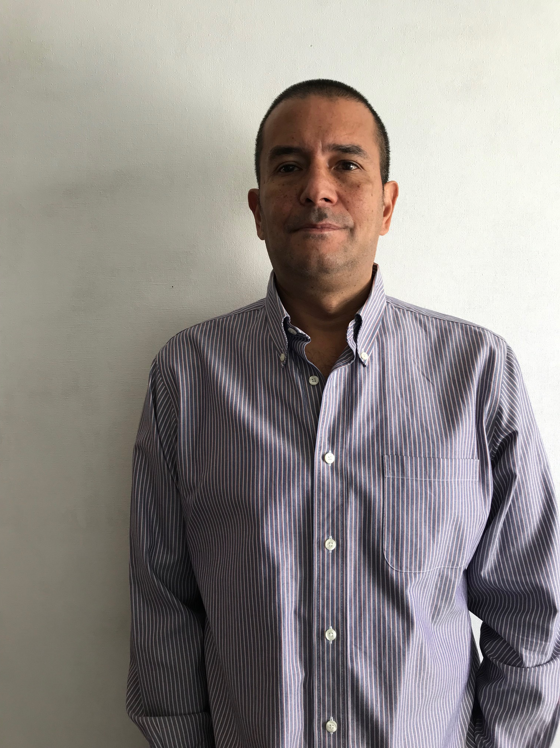
NATIONAL MENTORS
Ramón Molina, Mentor
Specialties: Innovation, Technology transfer, entrepreneurship.
Felipe Millar, Mentor
Specialties: Change Management, Technology Transactions, Computer Science.
Between 2002 and 2012 he served as Executive Director of the UAI Business School and as Director of its MBA programs. During his tenure, the Business School became number one in Latin America, and he also articulated one of the strongest Ecosystems of Innovation and Entrepreneurship. After that, he founded and led a company aimed at training the vulnerable segment for large-scale mining, taking advantage of the great demand for operators and mechanics that existed. He is currently a Partner of Wanka, real estate developer and director of KnowHub Chile.
Professor of entrepreneurship, business plans and technology transfer. A task oriented professional with capacity to lead diverse people and make them working as a team.
He is Civil Industrial Chemical Engineer, PUC. MBA Warwick University, UK. Entrepreneurship course. Symposia for Entrepreneurship Educators (SEE 2003) - Babson. Coach Program (2004) - Cognitive Behavioral Coaching - (U de Chile).
Felipe brings 25 years of experience in business and fund management. Specialized in strategic management of companies with a focus on business development in different industries; engineering, services, technology, media, digital marketing, E-commerce. High capacity for innovation, management of cultural change and high entrepreneurial spirit. Good performance in ambiguous environments.
Business and Administration degree, MBA IP UAI / Mentor Start Up Octantis UAI / IESE Senior Executive Program - Advanced Management Program / Certificate in the “Business Mentors” program, MBA / UCH Association.

Slide 15
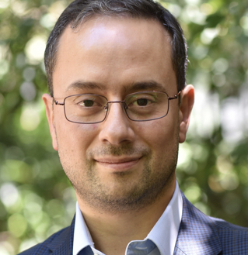
NATIONAL MENTORS
Darío Morales, Mentor
Specialties: Electric engineering, Technology transfer.
Jorge Karadima, Mentor
Specialties: Agrifood Business, Financial planning.
More than 15 years of experience in the energy industry from both the public and private sectors. In the private sector he served as Head of the Studies Area of ​​the Distribuidora Sociedad Austral de Electricidad and as Head of Solar Energy Projects of Acciona Energía Chile where he participated in the analysis of various business models and management of large-scale investment projects, particularly in the area of ​​renewable energy. In the public sector, he was Senior Energy Advisor and Deputy Director of Technology Transfer of the Chilean Innovation Agency (InnovaChile) and Director of Technology Centers of the Production Promotion Corporation (Corfo), where his participation in the attraction to Chile of the Centers of International Excellence in Applied R&D stands out. He currently works as Director of Studies of the Chilean Association of Renewable Energies (ACERA A.G.).
Civil Electrical Engineer from the University of Concepción, Chile; Doctor in Electrical Engineering from the University of Paris XI in France, and Master in Management and Technological Entrepreneurship from the Adolfo Ibáñez University in Chile.
Guest Professor of Corporate Finance in the Master of Agrifood Business Management at the Pontificia Universidad Católica de Chile. In addition, he is a business consultant and entrepreneur. Mr. Karadima led the first GP of Private Investment Funds focused exclusively on Agriculture in Chile for more than 10 years, managing more than 100 million dollars of assets under management (AUM), with high profitability and excellence. Mr. Karadima also worked over 6 years in Chiquita Costa Rica and Chile, where he held the positions of Innovation and Development Manager and Manager of Accounting and Financial Planning.
Before Chiquita, Mr. Karadima worked as Development Manager and Consultant for Europe and England at Agribiz.net. Previous experiences include six years at PepsiCo, Frito-Lay, both in England and Chile, where he held the position of Agricultural Manager and Project Manager.
Mr. Karadima is an Agricultural Engineer from the Pontificia Universidad Católica de Chile and has an MBA from the University of Cambridge, UK. He is both Chilean and British.

Slide 16
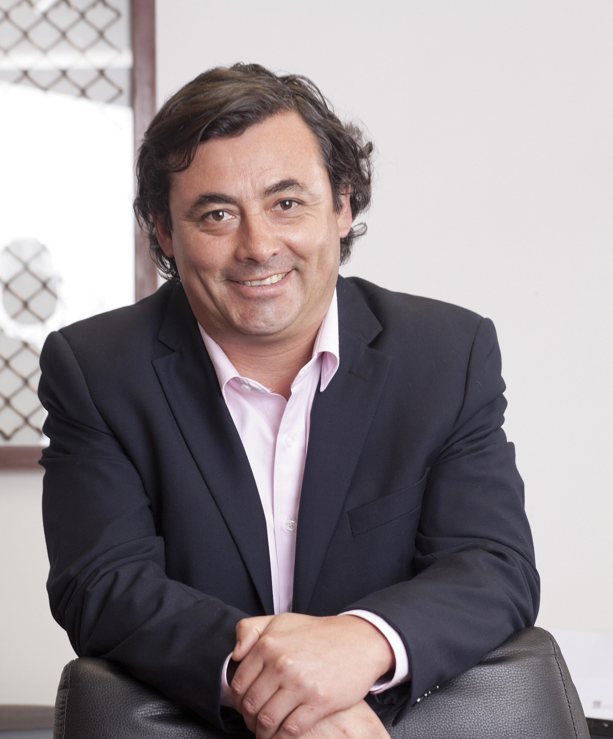
NATIONAL MENTORS
Víctor Pérez, Mentor
Specialties: Mining, Finance, Marketing, Venture Capital, Sustainability, Green Copper.
Jorge Nitsche, Mentor
Specialties: Technology Transactions, agricultural business and products development.
Victor is a part-time professor of Strategic Marketing in the Mining MBA of the University of Chile. He has a Coaching program certification in Newfield. As a Codelco executive for 21 years, he represented this Corporation in many organizations. He has participated in different committees at the International Copper Association (ICA), the International Council of Mining and Minerals (ICMM), Alta Ley, Cesco, Consejo Minero, among other mining entities.
Victor has directly supported more than 100 startups in Chile for more than 12 years, including the formation of the first Venture Capital Fund focused on technologies inside the copper value chain (Aurus VC III), investing in 13 startups, for amounts close to US $ 65 million. Víctor is currently Executive Director of ASDIT, Director of Green Mining at Corporation Alta Ley, Member of Cesco and Voces Mineras, Advisor at Aurus VC Fund,
He is a graduate of Business Administration and a Commercial Engineer from the University of Chile. He has a Master of Administration from Boston University (London Campus) and a Master of Finance from the Imperial College of London and a Diploma in VC Funds from University Adolfo Ibáñez
From January 1992 to 2015, he worked as Technical Manager of BASF Pacific zone in Santiago, Chile. From 2016 to June 2019 worked as BASF Innovation Manager for the Pacific zone (Mexico to Chile). Since 2000, He has created and developed QL Agri, Pholus and Elenquo products, based on Quillay extracts and which are part of the BASF offer. Since 2018, He is Knowhub Director, President of Oliveros de Lolol S.A., and Advisor to agricultural companies in development and commercialization of organic products.
He is Agronomist from Universidad de Chile and Diploma in Marketing and Leadership from Universidad Catolica de Chile.

Slide 17
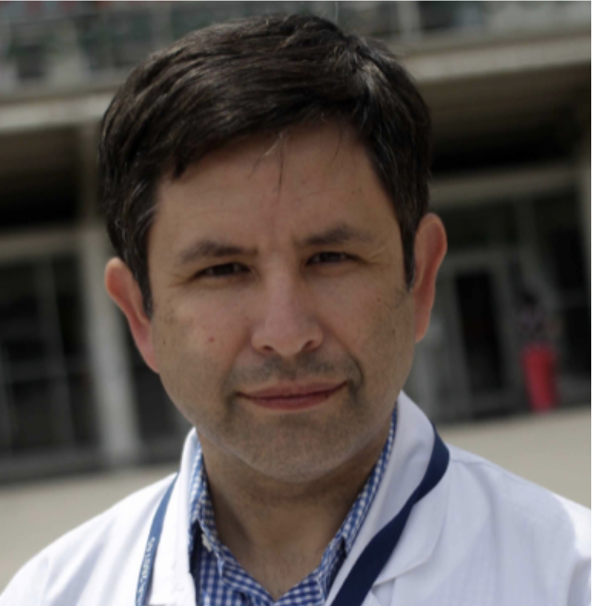
NATIONAL MENTORS
Hernán Bustamante, Mentor
Specialties: Medicine, innovation.
Medical Director Hospital Padre Hurtado. Professor and Researcher Center for epidemiology and Health Policies Facultad de Medicina Clinica Alemana-Universidad del Desarrollo. Professor and Researcher Departamento de Control de Gestión y Sistemas de Información. Facultad de Economia y Negocios. Universidad de Chile. Mentor at Imagine Lab.
Experience in Mentoring in Health and Technology areas. National and International Consultant in Public and Private Institutions. Experience in evaluating social development projects, outcome research, pharmacoeconomics, storytelling and health innovation.
Medical Surgeon University of Concepción. Master of Business Administration Tulane University. Magister en Administración Universidad de Chile. Courses in Mentoring, Storrytelling and film script.

